Slide 1

Classic Models

Slide 2
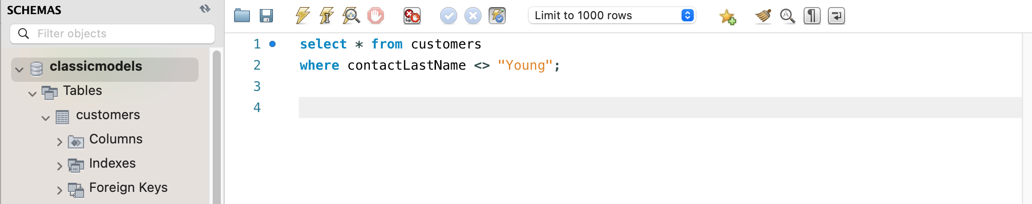
1) All Records where customers last name is not Young SELECT * FROM classicmodels.customers where contactLastName <> 'Young’;

Slide 3
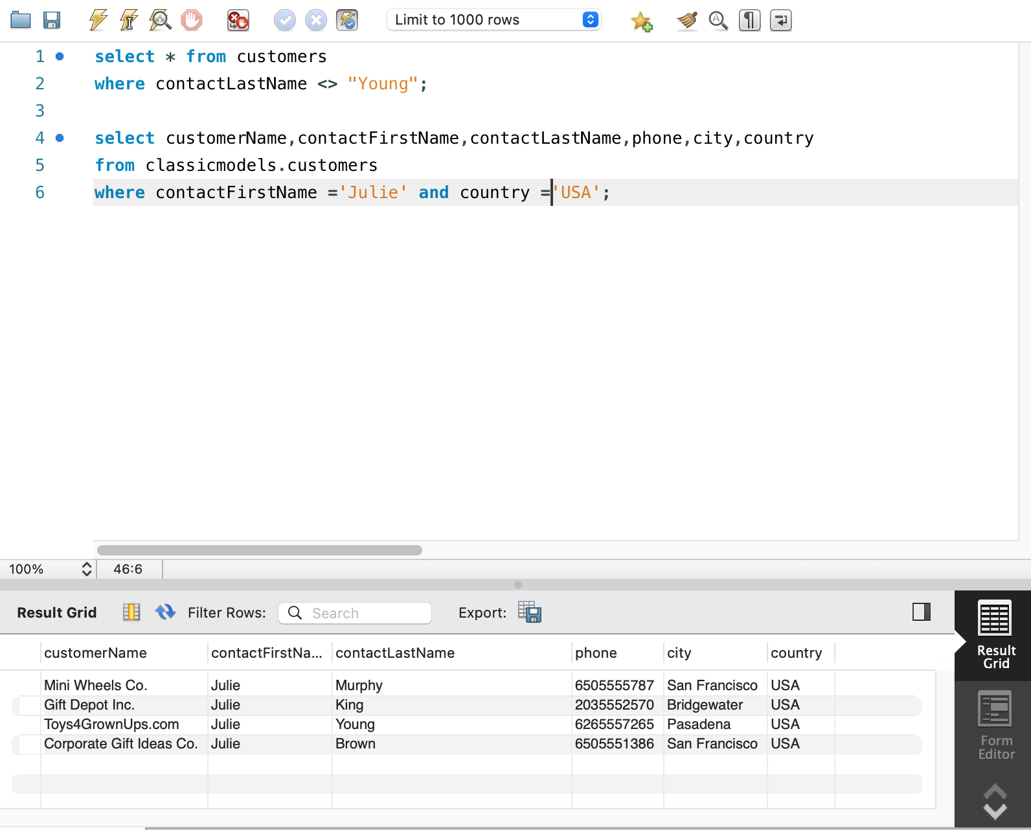
2) Show Customername, First Name, Last Name, phone, City & Country where First name is Julie and she is from USA SELECT customername, contactfirstname, contactlastname, phone, city, country FROM classicmodels. customers where country = 'USA' and contactfirstname = 'Julie'

Slide 4
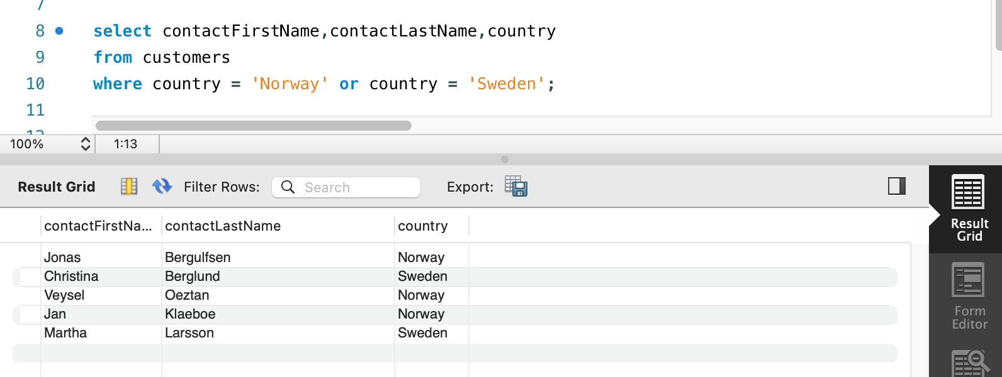
3) First Name and Last name for customers from Norway or Sweden: SELECT contactfirstname, contactlastname FROM classicmodels.customers where country = 'Norway' or country = 'Sweden'

Slide 5
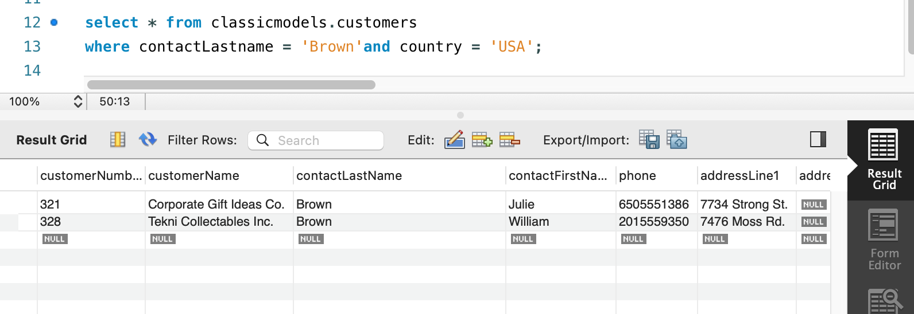
Show all columns for customers from the USA with surname Brown

Slide 6
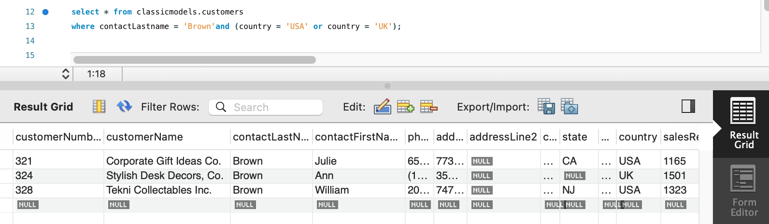
Show all columns for customers from the USA and Uk with surname Brown

Slide 7
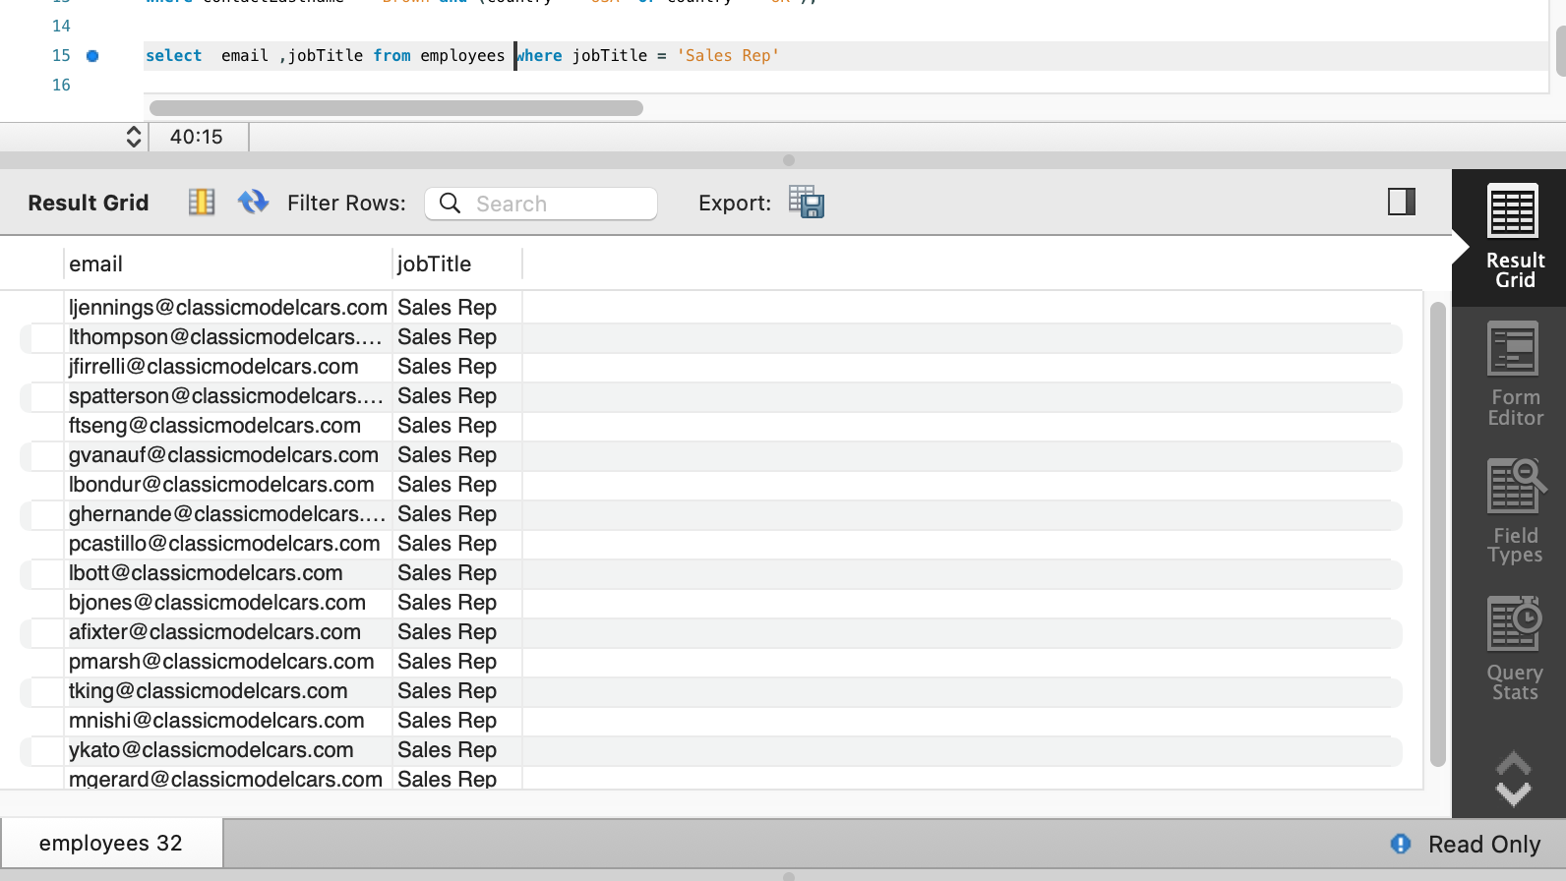
For employees who are sales reps, display their email.

Slide 8
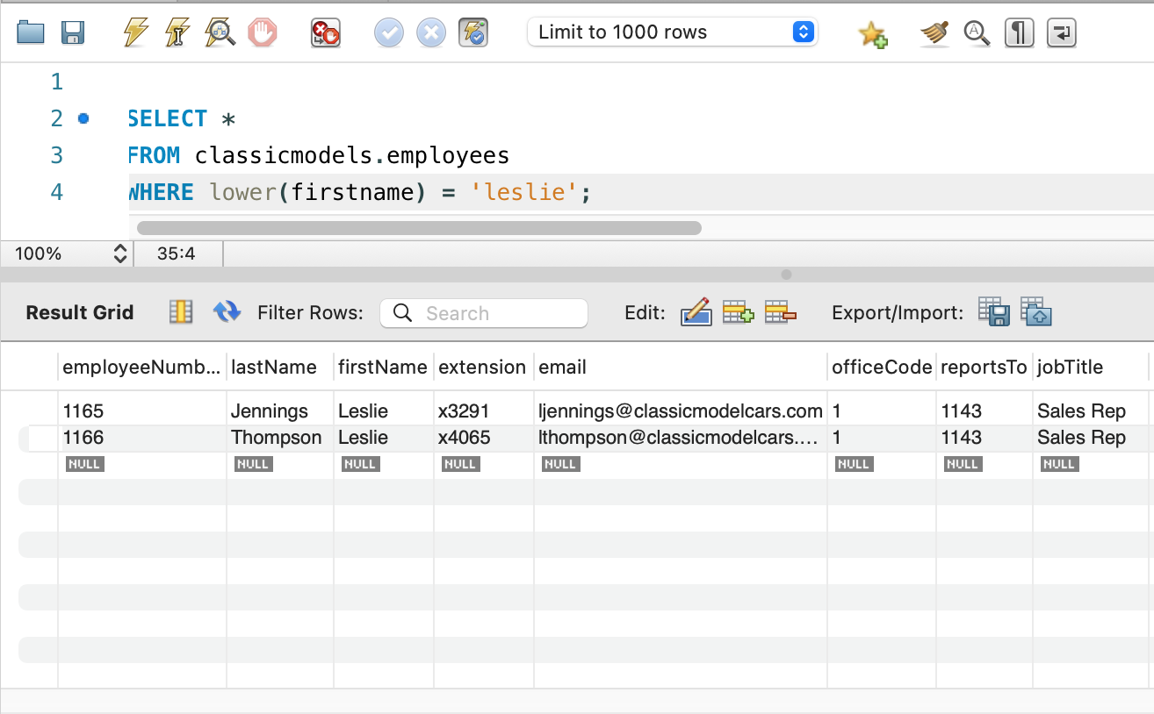
LOWER()select all columns with Leslie use lowercase

Slide 9
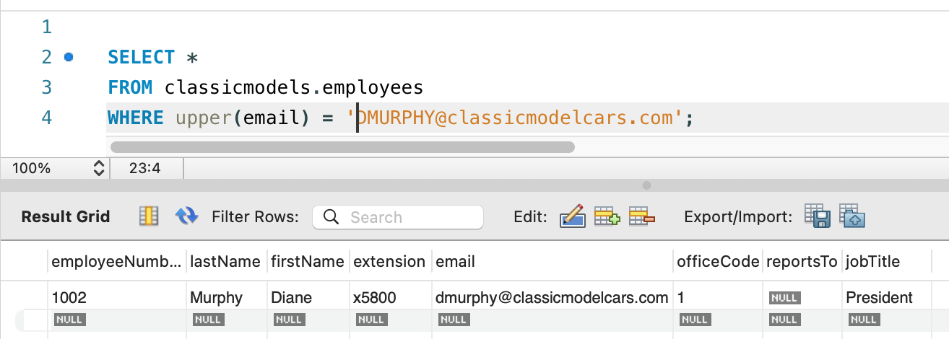
upper()select all columns with email‘DMURPHY@classicmodelcars.com’use upper

Slide 10
upper()select all columns with email‘DMURPHY@classicmodelcars.com’use upper

Slide 11
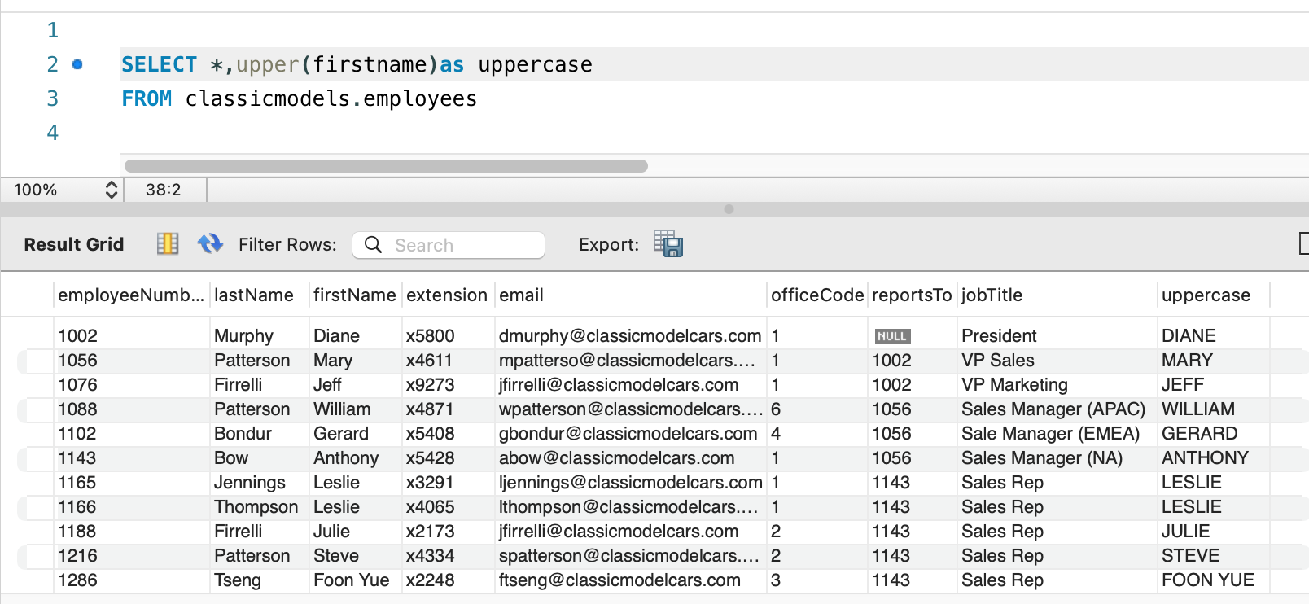
New column with firstname in uppercase

Slide 12
- IN() - PUT MULTIPLE CONDITIONS IN BRACKETS

